Slide 1


Slide 2


Slide 3

http://www.google.com,
http://Instagram.com//y64hy

Slide 4
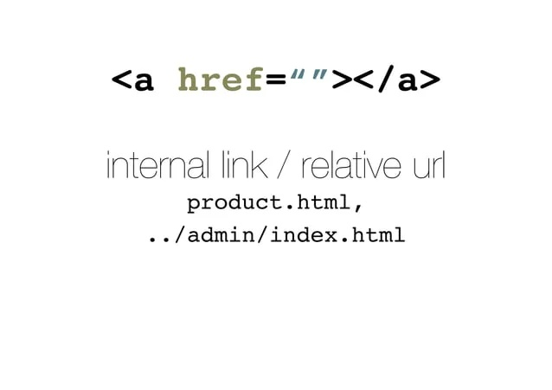

Slide 5


Slide 6
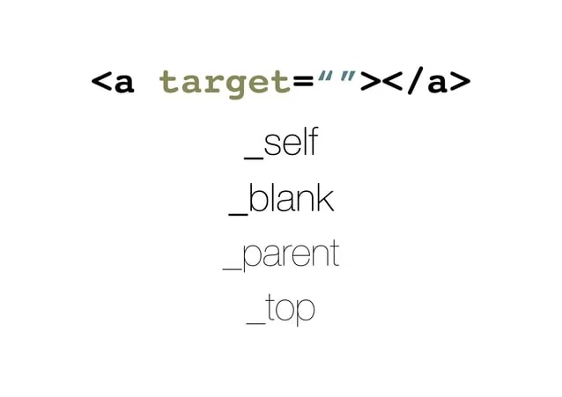

Slide 7


